Slide 1
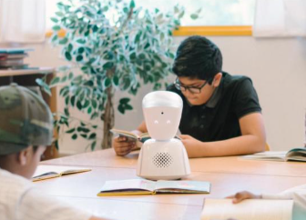
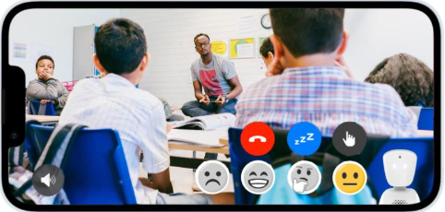
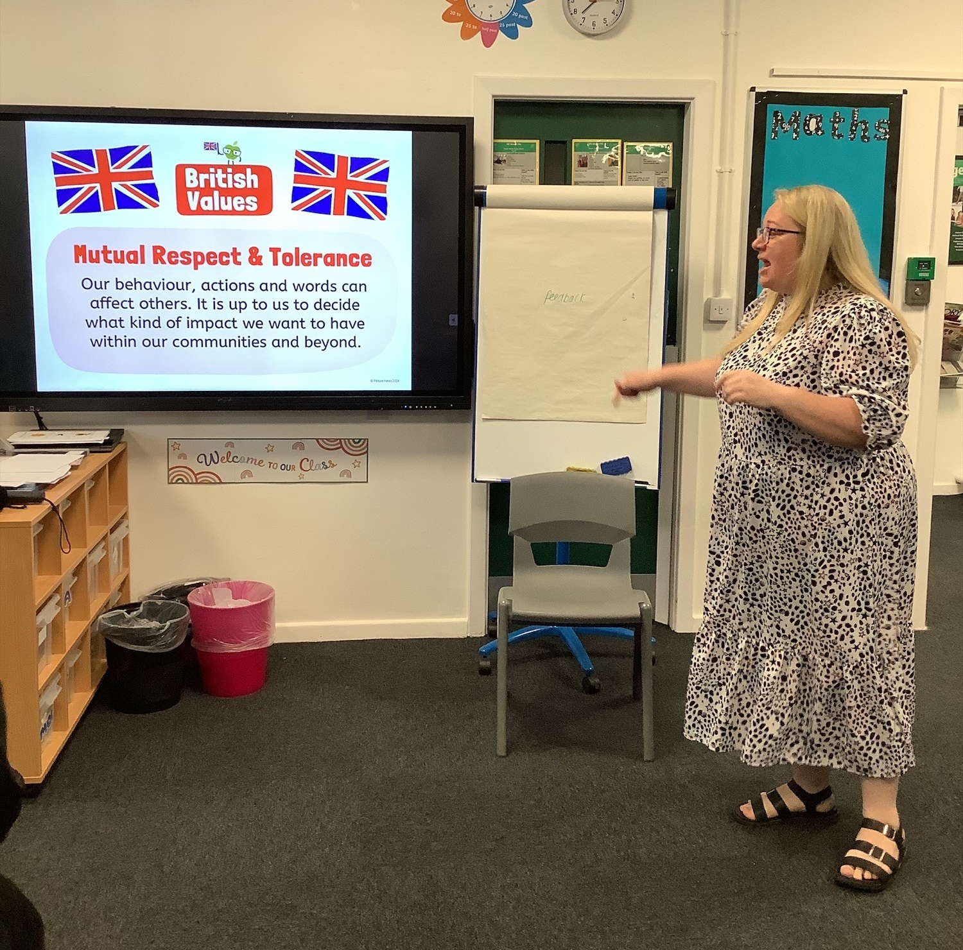
September 2024
Newsletter
Dear Parents, Carers and Pupils,
As we embark on this new term, I'm filled with excitement about the positive changes and growth we're experiencing at our school. It's heartening to see our pupils settling into their new classrooms, embracing the fresh surroundings with enthusiasm. The new café, toilet facilities, and medical room have been particularly well-received, enhancing our learning environment.
In our ongoing efforts to support all pupils, regardless of their circumstances, we've invested in an exciting piece of technology – the AV1 school robot! This innovative tool allows pupils who are unable to attend school in person, due to medical treatment or recovery, to participate fully in classroom activities. AV1 acts as their eyes and ears, enabling them to listen, watch, ask questions, and join discussions from wherever they are. We'll be introducing AV1 to our classrooms over the coming weeks, ensuring that every pupil has the opportunity to engage in both the educational and social aspects of school life.
Our first whole school assembly of the academic year, led by Mrs Blake our new Assistant Head and SENDCO, was a resounding success. We've chosen 'Don't Stop Believing' as our school song for this term – a fitting choice that encapsulates the spirit of perseverance and hope that we foster here at The Sullivan Centre. To make our singing even more inclusive, we're learning the Makaton signs to accompany the lyrics, allowing everyone to join in and express themselves.

Slide 2
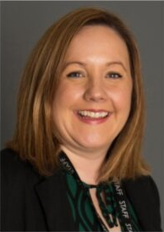
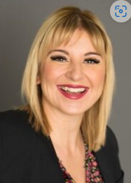
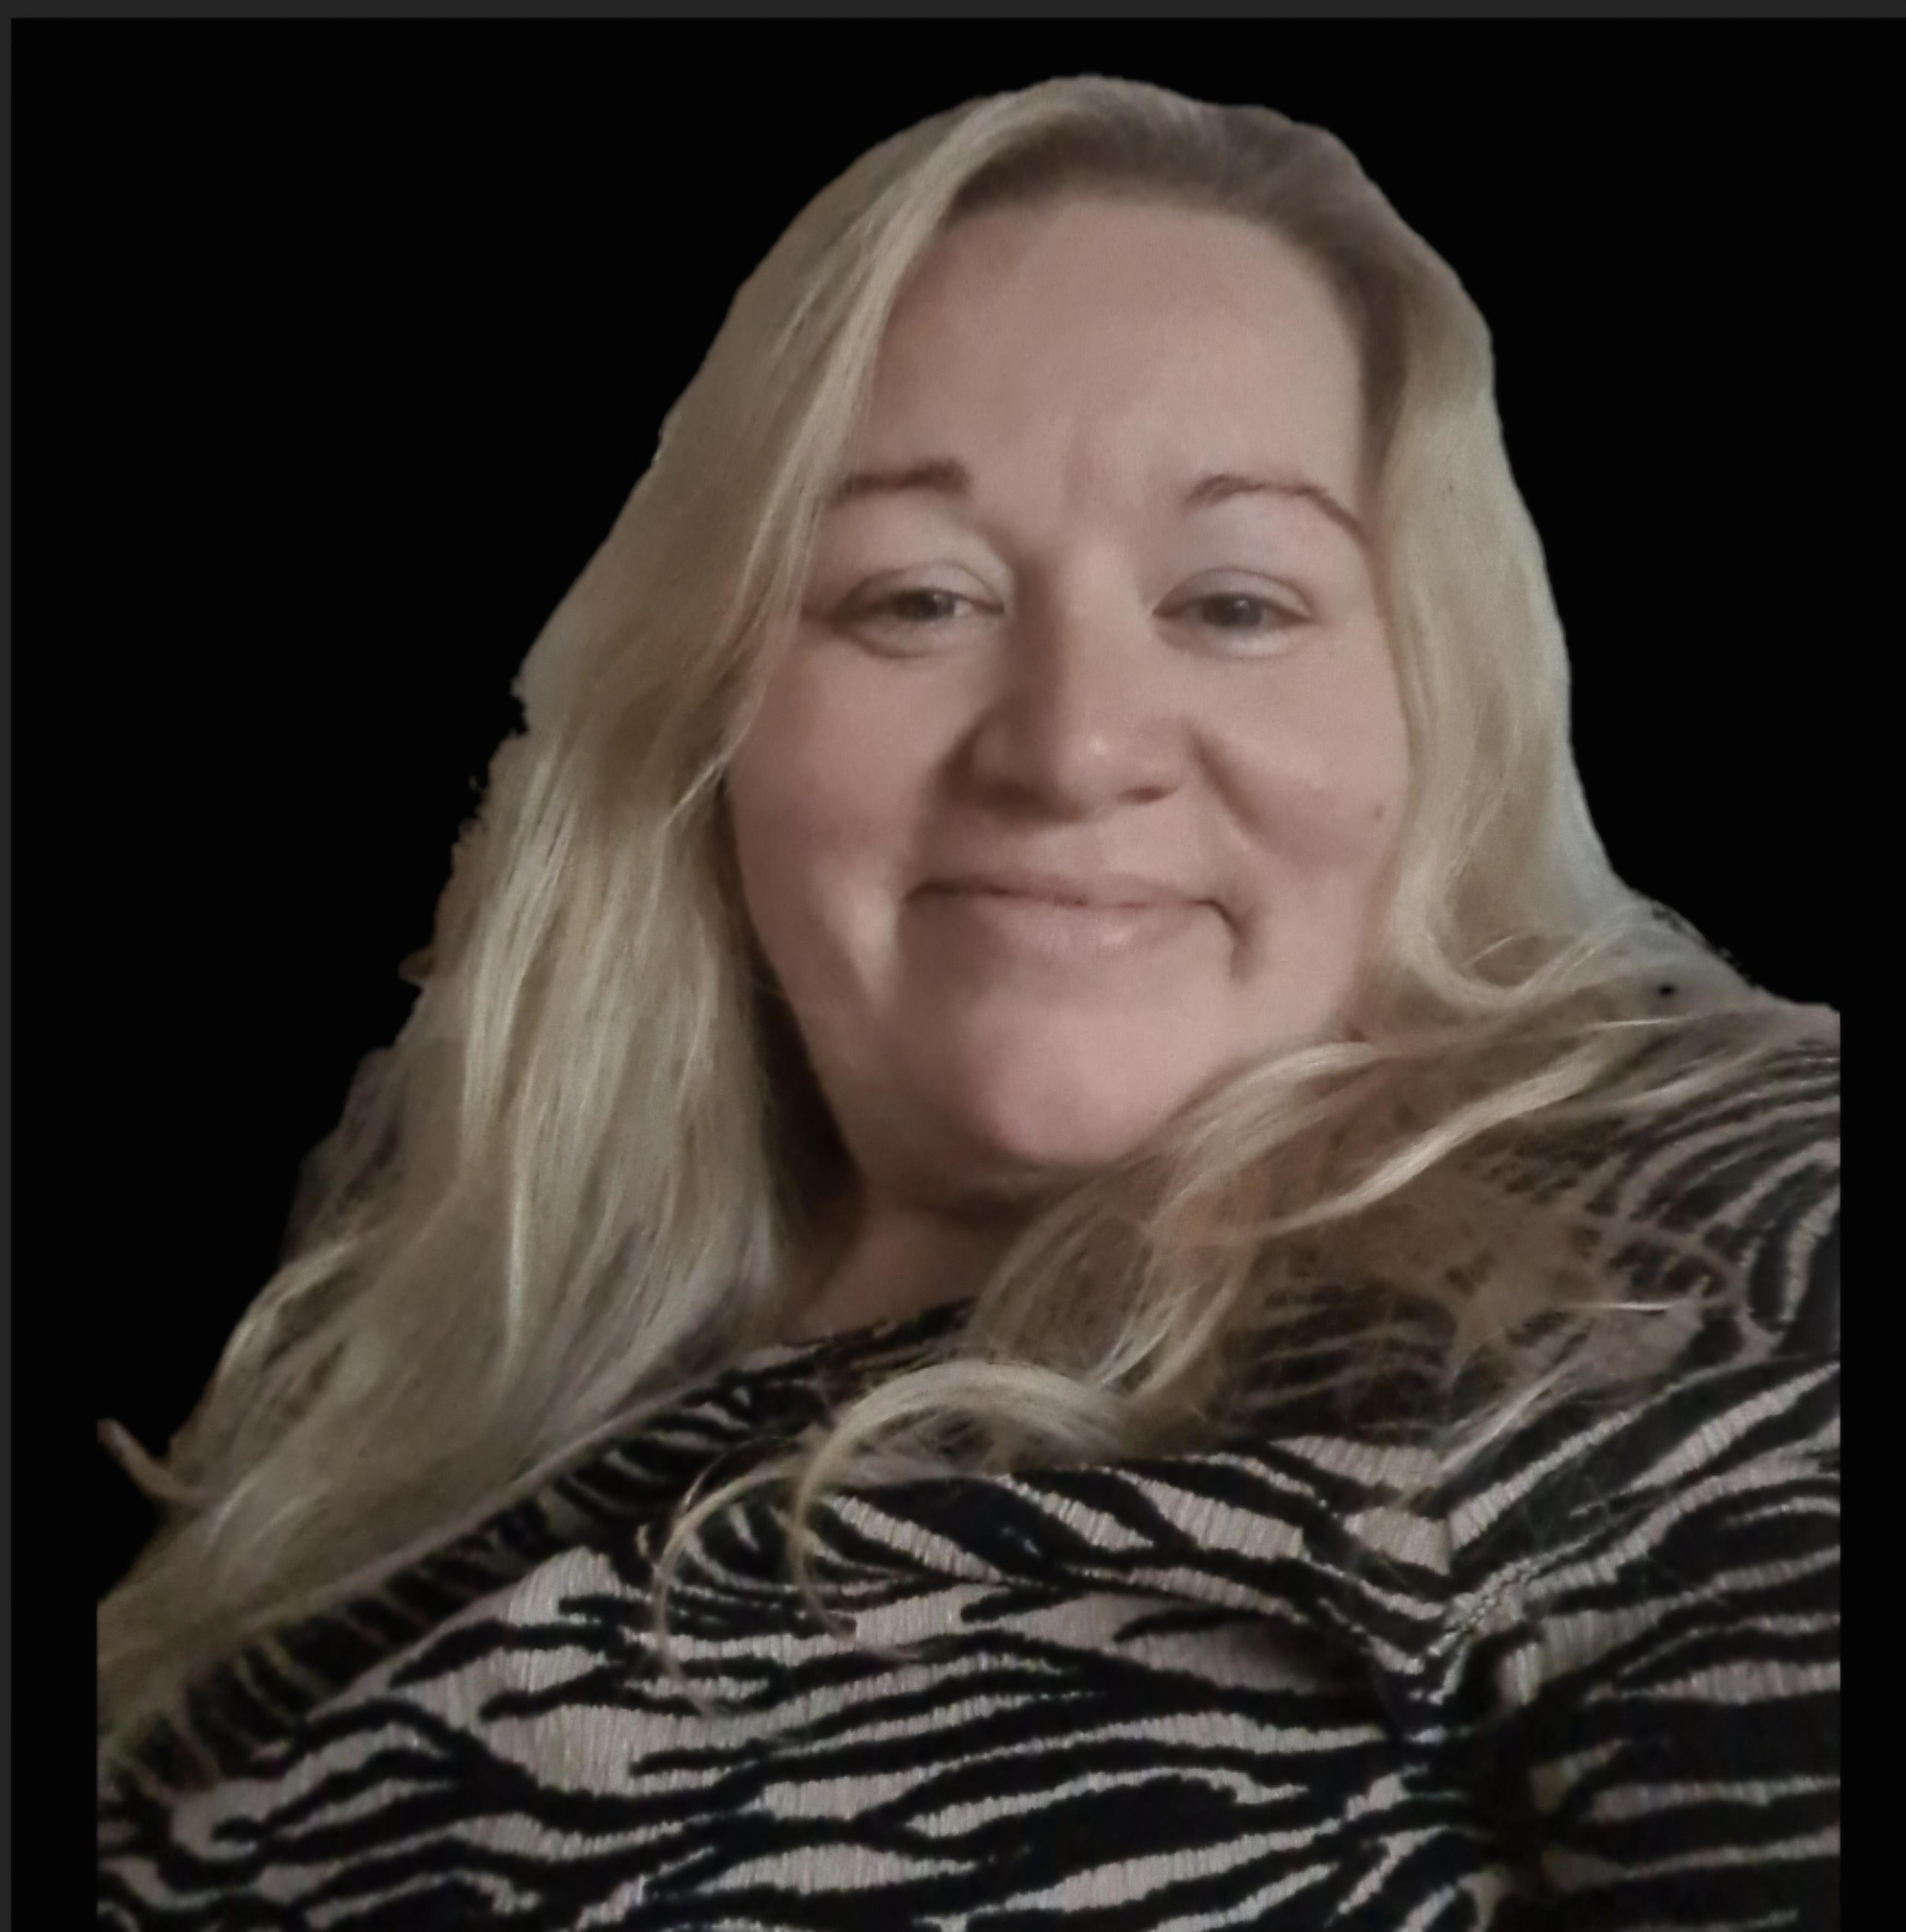
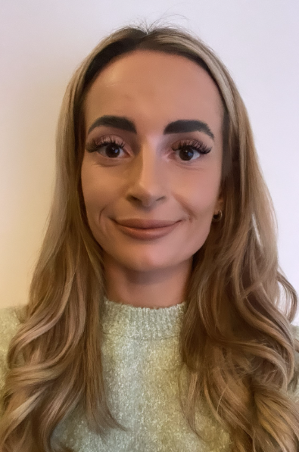
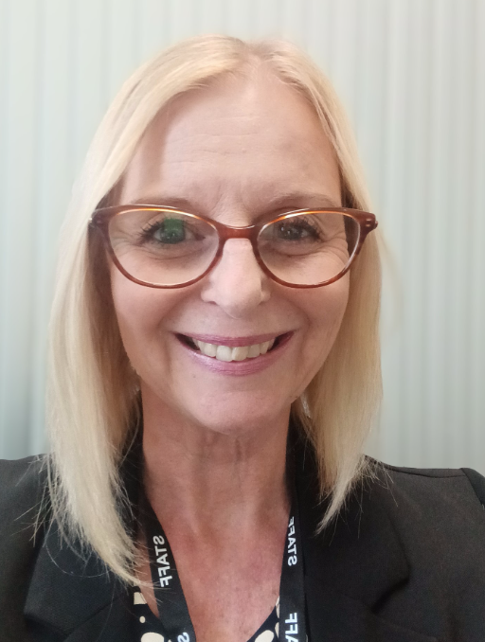
Mrs Blake is our Assistant Headteacher and SENDCO
Mrs Troake is our Head of School
Miss Goodaire is our Executive Headteacher
Mrs Megan Cook is our Attendance and Welfare Officer.
Ms Samantha Stockton is our Safeguarding and Welfare Lead.
PE KITS
Pupils who have PE on a Monday or Thursday may wear PE kits to school that day. If you are not sure, please contact the school.
Date For Your Diary
Friday 20th September-Jeans for Genes Day- Pupils invited to come in jeans
Monday 30th September- School Surgery 3.30-5.30pm (Virtual)
Wednesday 9th October- Careers Coffee morning drop in- your chance to pop into school to discuss anything careers related with our Careers Team
Thursday 10th October- World Mental Health Day- Wear Yellow
Thursday 17th October- Foundations Live Event Bishop Burton (Year 11 only)
Friday October 25th- Proud Parents event 10am-11.30am

