Slide 1
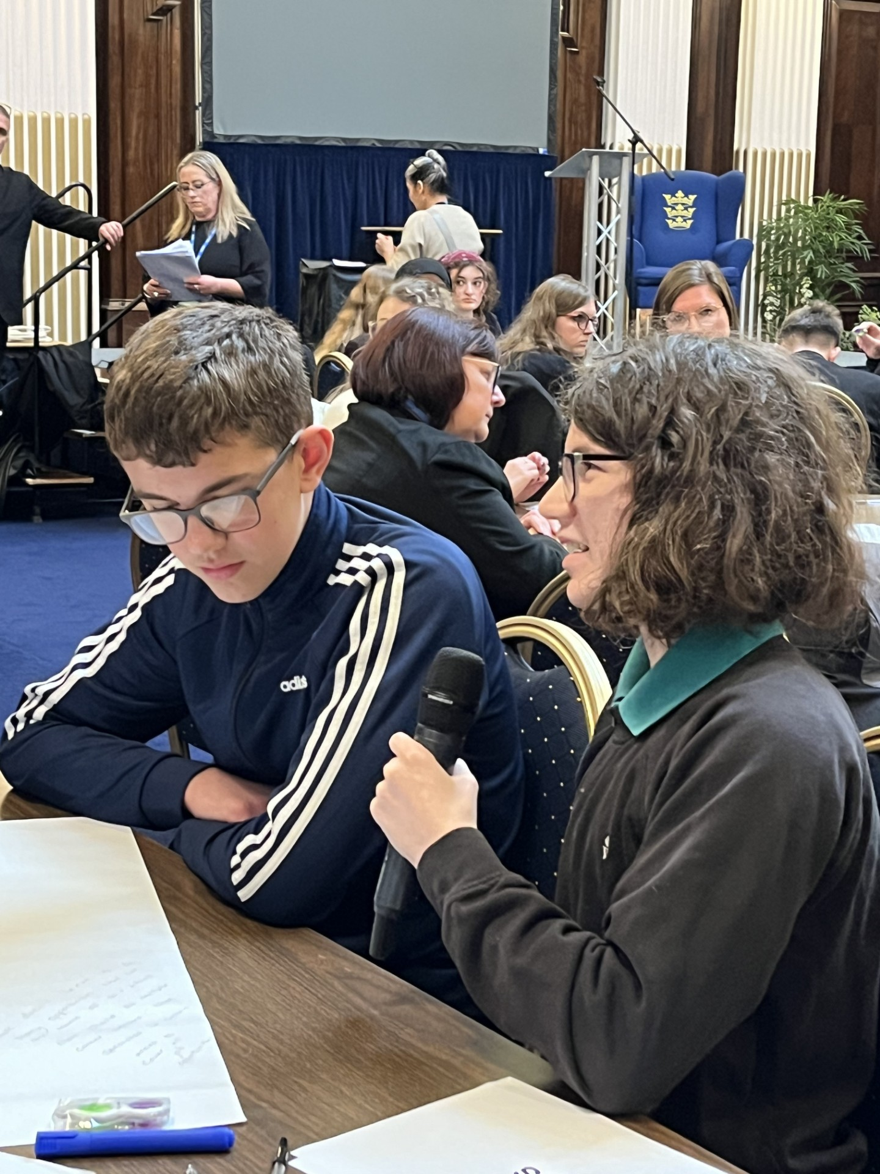
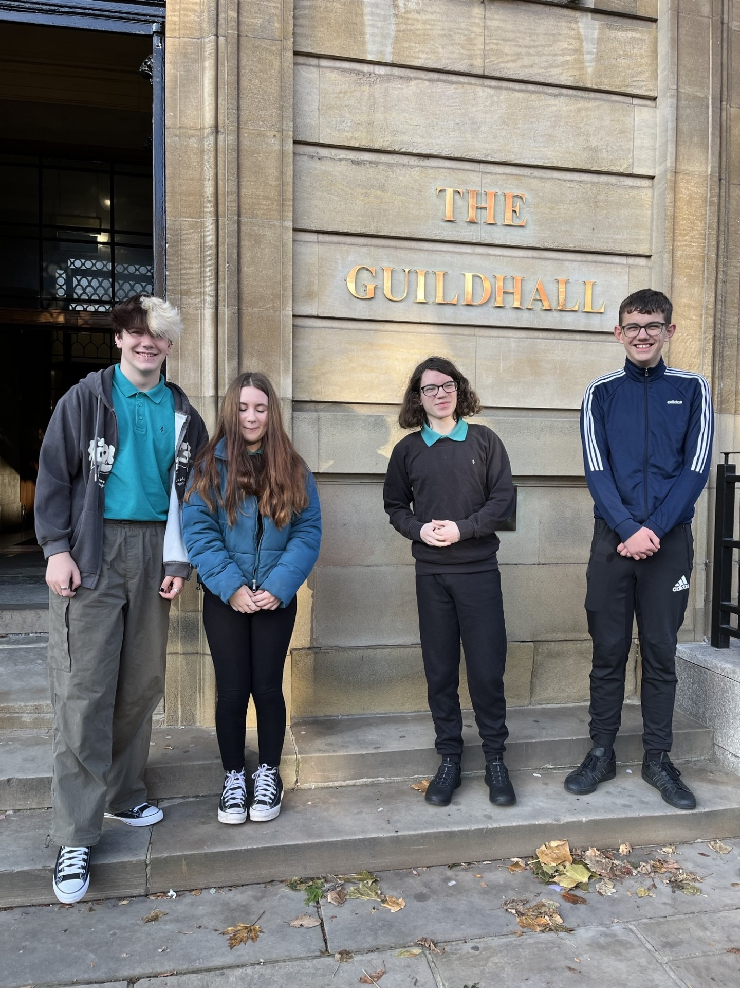
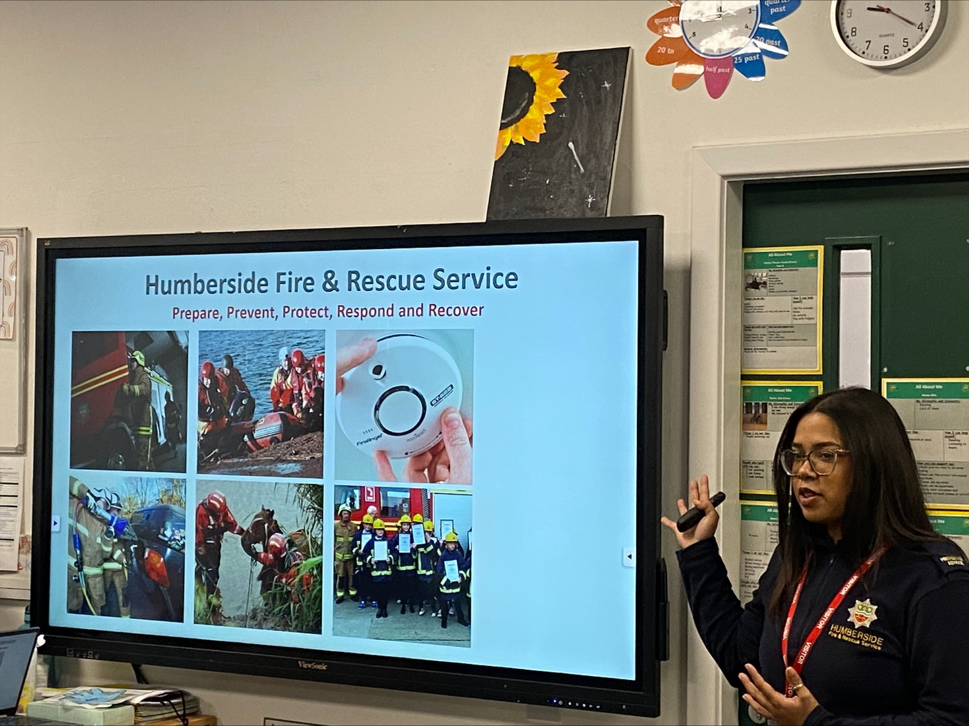
November 2024
Newsletter
Dear Parents, Carers and Pupils,
What a whirlwind of a half term we've had! I'm bursting with pride at the exceptional efforts of our pupils, who have truly gone above and beyond in their learning and personal growth. One of our most exciting developments has been the introduction of the AV1 robot in our classrooms. This innovative technology is bridging the gap for our pupils who are too unwell to attend in person, ensuring they remain connected to their peers and engaged in their learning journey. It's heartwarming to see how this initiative is making a real difference in the lives of our most vulnerable learners.
I'm thrilled to announce the establishment of our School Council, giving our pupils a strong voice in shaping their educational experience. Recently, our councillors participated in a trip to the Guildhall, where they courageously spoke in front of a large audience of adults and peers about the pressing issues facing Hull's youth today. Their articulate and thoughtful contributions made us all incredibly proud.
Our commitment to fostering strong partnerships with parents has seen us host a variety of events. Our first careers coffee morning was a resounding success, providing valuable insights into future pathways for our pupils. We've also held virtual school surgeries and proud parents events, creating more opportunities for you to engage with your child's education and celebrate their achievements.
Safety is always a top priority, and with Bonfire Night approaching, we were fortunate to have a visit from the Humberside Fire and Rescue team. They delivered an informative talk on firework safety and the laws, equipping our pupils with essential knowledge to stay safe during the festivities.

Slide 2
Now, I'm excited to share a challenge that's close to our hearts. The Sullivan Centre is taking on the '100 Push Ups a Day Challenge' throughout November to raise funds for Great Ormond Street Hospital. This incredible charity has touched the lives of those in our community, and we're determined to make a difference. We'd be incredibly grateful for your support in this endeavour.
You can follow our progress and make a donation through our fundraising page: https://fundraise.gosh.org/fundraisers/TheSullivanCentre/100-push-ups-a-day-challenge-november
As we move forward, let's continue to work together, celebrating our pupils' resilience, creativity, and determination. Your ongoing support and engagement are vital to our school's success, and I'm deeply grateful for the strong community we've built together. Here's to another term of growth, achievement, and positive change at The Sullivan Centre!
PE KITS
Pupils who have PE on a Monday or Thursday may wear PE kits to school that day. If you are not sure, please contact the school.
Date For Your Diary
6th November & 7th November- Parent/Teacher consultations
11th November- Antibullying Week
15th November- Children in Need-non uniform suggested donation 50p
18th November- Road Safety Week
25th November-Mock Exam Week
5th December- School choir performance at Hull Royal
6th December- School closure day
10th December- Science summit trip KS3
12th December- Wear Christmas Colours, whole school Theatre trip.
13th December- Christmas craft day and Christmas Dinner. Parents welcome from 11am
16th December- Enterprise Week
19th December- Enterprise Fair 10.30-12pm
19th December- School closes for Christmas 1pm

