Slide 1
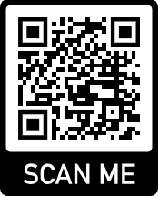
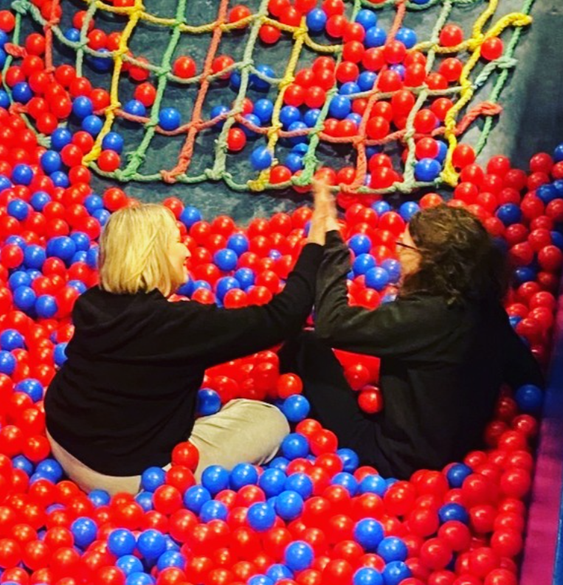
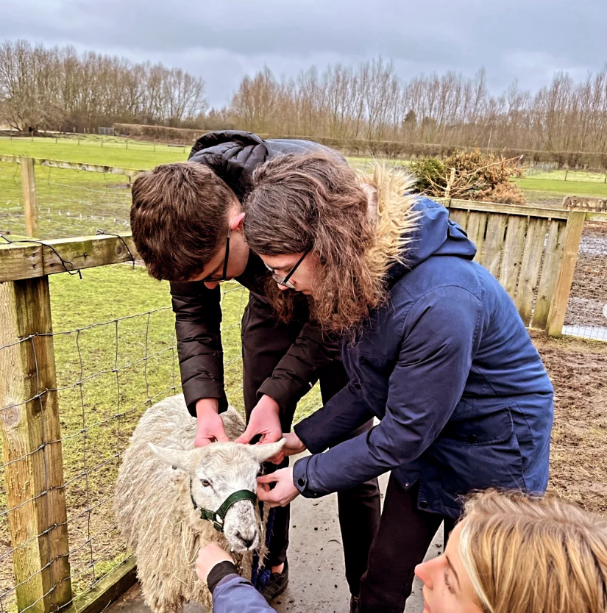
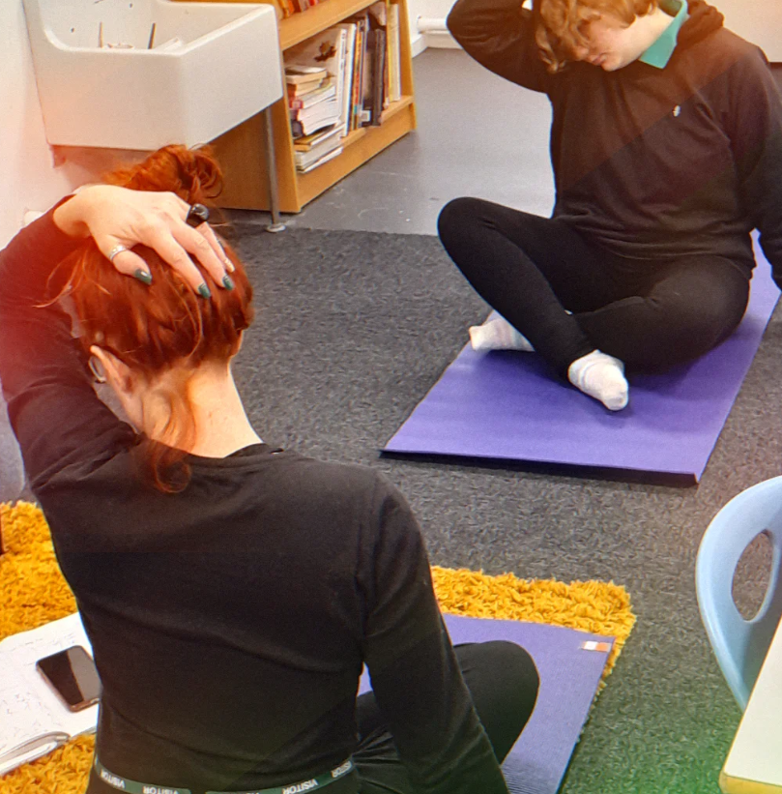
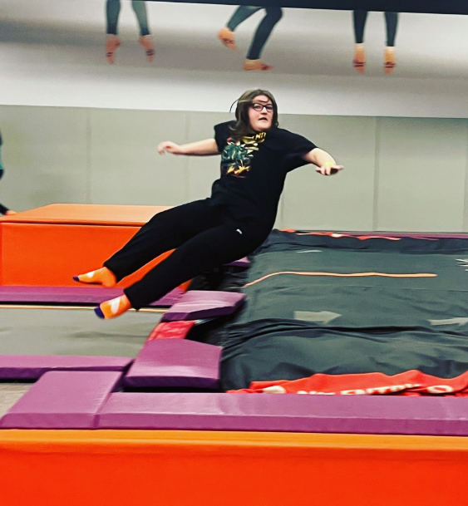
February 2025
Newsletter
Dear Sullivan Centre Community,
I hope this newsletter finds you all well and refreshed after the half-term break. It's wonderful to have our pupils back, bringing their energy and enthusiasm to our corridors once again. I'm thrilled to share some exciting updates about our enhanced enrichment programme. We've been witnessing remarkable progress in our pupils' confidence and skills through a variety of engaging activities. From the serene experience of alpaca walking to the exhilarating challenges at Gravity, our young people are pushing their boundaries and discovering new strengths.
These diverse activities are not just about fun – though there's plenty of that! They're carefully designed to build self-assurance, teamwork, and resilience. It's heartening to see our pupils embracing these opportunities with such gusto and growing in confidence with each passing day.
At The Sullivan Centre, we're committed to providing a supportive environment where every pupil can thrive. The progress we're seeing is a testament to the hard work of our pupils, the dedication of our staff, and the invaluable support from our families. Thank you all for your continued support and engagement. Here's to another term of growth, achievement, and positive experiences!

Slide 2
Date For Your Diary
3rd March- National Careers Week in School
6th March-World Book Day- Non uniform/come dressed as a book character if you wish!
6th March- Humberside Airport Visit Key Stage 4
10th March British Science Week!
17th March- Mock Week- See attached timetable
21st March- Red nose day/Comic Relief- Wear something red!
24th March- Virtual School surgery with Mrs Troake and Mrs Blake
26th March- Parent consultations 3.15-5pm
28th March-Wear a Hat Day (Brain Tumour Research)
31st March- Flat Stan First Aid Workshop in school
4th April- Proud parents Morning with Easter crafts sale fundraiser for Dove House Hospice
4th April- School closes for Easter at 3pm
Reminders: We understand that each of our pupils has individual needs, and we strive to accommodate these as best we can. Our uniform policy is designed to create a sense of unity and belonging among our pupils, while also preparing them for the expectations they may encounter in future educational or professional settings.
With this in mind, we kindly ask for your support in ensuring that your child wears their school uniform whenever possible. We recognise that there may be sensory or medical considerations that make this challenging for some pupils, and we're more than happy to discuss these on an individual basis. If you find yourself in need of new uniform items for your child, please don't hesitate to reach out to our office staff. They'll be more than happy to assist you in obtaining the necessary items.
School Policies - The Sullivan Centre - Venn Academy Trust
PE KITS
Pupils who have PE on a Monday or Thursday may wear PE kits to school that day. If you are not sure, please contact the school.

Slide 3
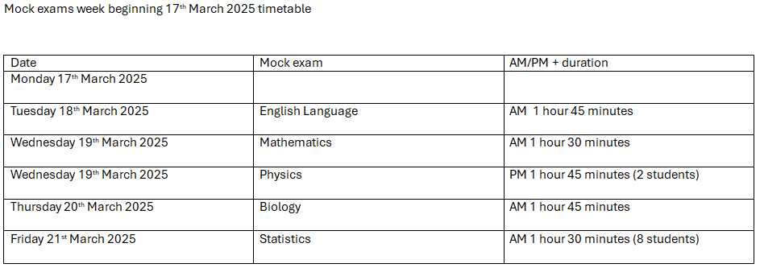
Keep up to date with all our news and activities through our Instagram Page!
https://www.instagram.com/thesullivancentre/

